Slide 1


Arthur Paruzel
10/28/2022

Slide 2

Outline
Executive Summary
Introduction
Methodology
Results
Conclusion
Appendix

Slide 3
Executive Summary
Summary of methodologies
Data Collection and Aggregation using API
Data Collection and Aggregation using web scraping
Data Wrangling
Exploratory Data Analysis using SQL and IBM DB2
Exploratory Data Analysis with Python and Matplotlib/Seaborn
Interactive Visual Analytics with Folium
Interactive Visual Analytics with Python and Plotly
Machine Learning Modelling and Prediction
Supervised machine learning algorithms: K-Nearest Neighbors, Tree, Supported Vector Machine, Logistic Regression
Model Optimization using Grid Search and scoring: F1
Summary of all results
Exploratory Data Analysis Results
Interactive Visual Analysis Results
Predictive Analysis Results

Slide 4
Introduction
Project background and context
Space X advertises Falcon 9 rocket launches on its website with a cost of 62 million dollars; other providers cost upward of 165 million dollars each, much of the savings is because Space X can reuse the first stage. Therefore, if we can determine if the first stage will land, we can determine the cost of a launch. This information can be used if an alternate company wants to bid against space X for a rocket launch. This goal of the project is to create a machine learning pipeline to predict if the first stage will land successfully.
Problems you want to find answers
- What factors determine if the rocket will land successfully? - The interaction amongst various features that determine the success rate of a successful landing. - What operating conditions needs to be in place to ensure a successful landing program.

Slide 5

Section 1

Slide 6
Methodology
Executive Summary
Data collection methodology:
Data was collected using SpaceX API and web scraping from Wikipedia
Perform data wrangling
One-hot encoding was applied to categorical features
Perform interactive visual analytics using Folium and Plotly Dash
Perform predictive analysis using classification models
4 classifiers were determined to fit the Predictive Analysis, Logistic Regression, Supported Vector Machine, Decision Tree and K Nearest Neighbors. All 4 classifiers were built, trained and then tested on the available dataset, to determine the model with highest prediction accuracy. For each model type multiple parameters were evaluated to fine tune the model to the best results.

Slide 7
Data Collection
The data was collected using various methods - Data collection was done using get request to the SpaceX API. - Next, we decoded the response content as a Json using .json() function call and turn it into a pandas dataframe using .json_normalize(). - We then cleaned the data, checked for missing values and fill in missing values where necessary. - In addition, we performed web scraping from Wikipedia for Falcon 9 launch records with BeautifulSoup. - The objective was to extract the launch records as HTML table, parse the table and convert it to a pandas dataframe for future analysis.

Slide 8
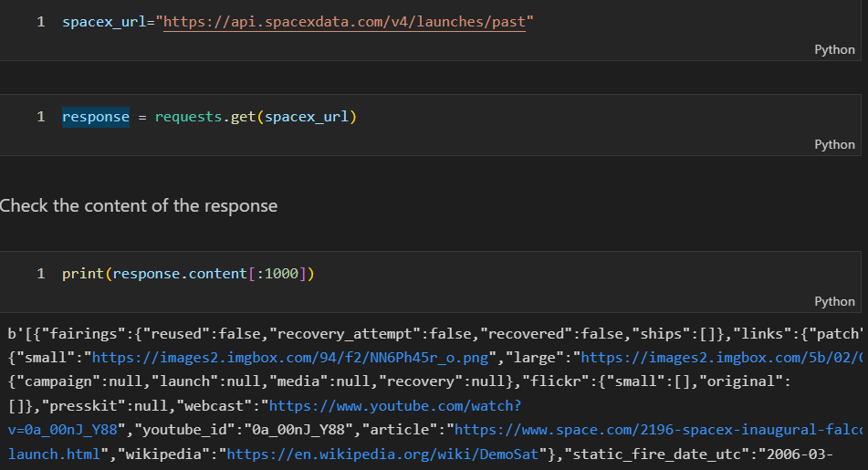
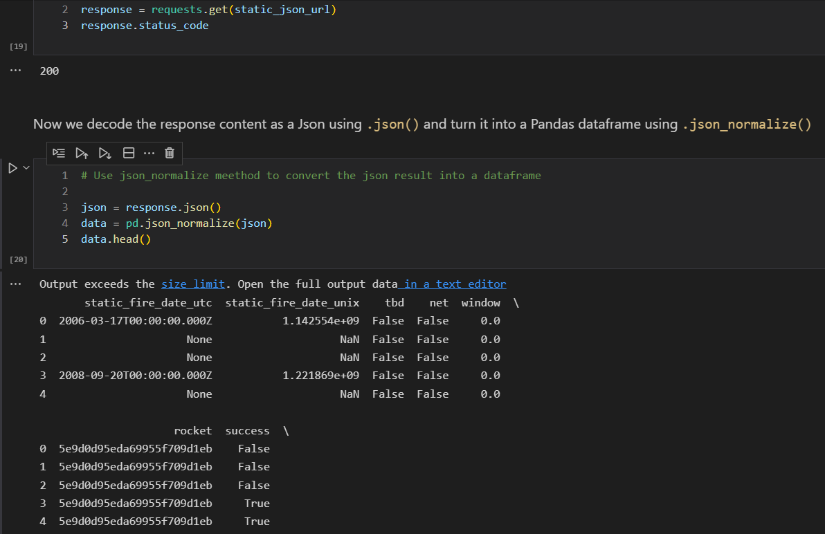
Data Collection – SpaceX API
Present your data collection with SpaceX REST calls using key phrases and flowcharts
Add the GitHub URL of the completed SpaceX API calls notebook (must include completed code cell and outcome cell), as an external reference and peer-review purpose

Slide 9
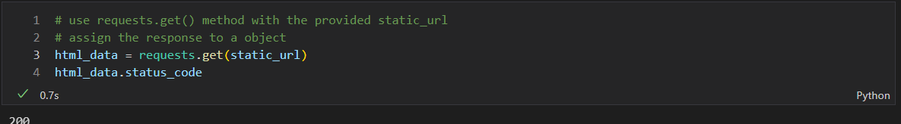
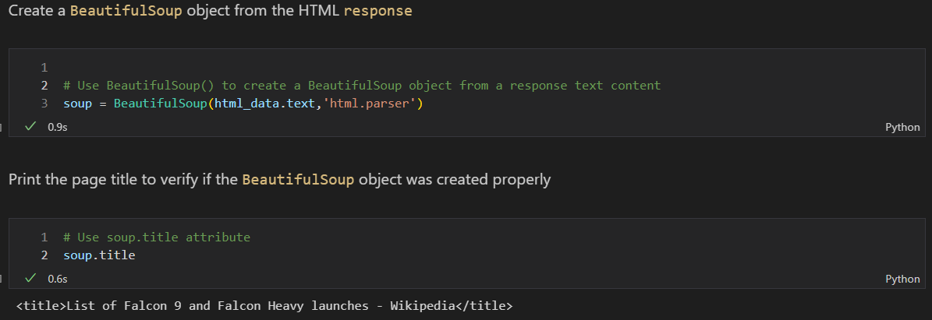
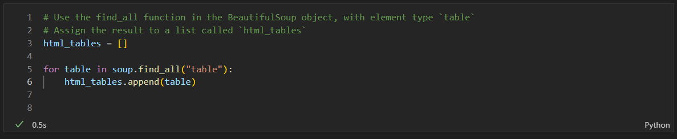
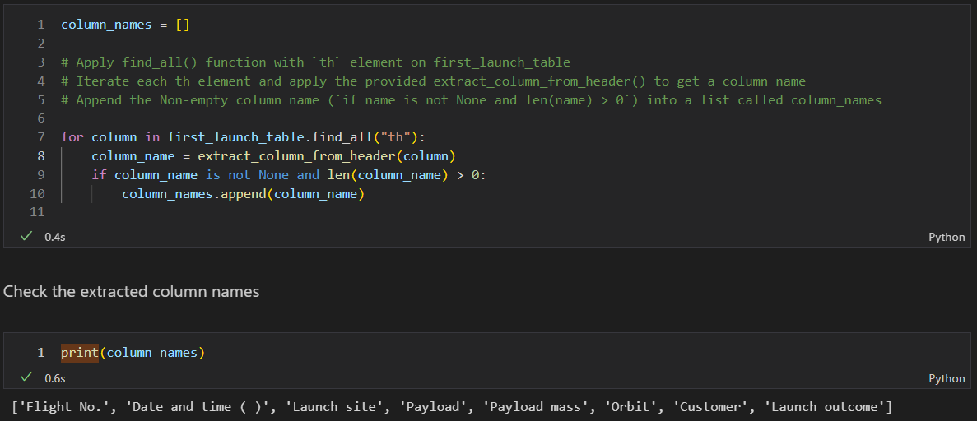
Data Collection - Scraping
Present your web scraping process using key phrases and flowcharts
Add the GitHub URL of the completed web scraping notebook, as an external reference and peer-review purpose

Slide 10
Data Wrangling
Describe how data were processed
Data was loaded into Pandas DataFrame
We identified the percentage of missing values for each attribute
We identified which columns are numerical and categorical
We calculated number of launches for each site
We calculated the occurrences of each mission for each orbit
We calculated distribution of mission outcome for each orbit
We created landing outcome (success/failure) for each mission.

Slide 11
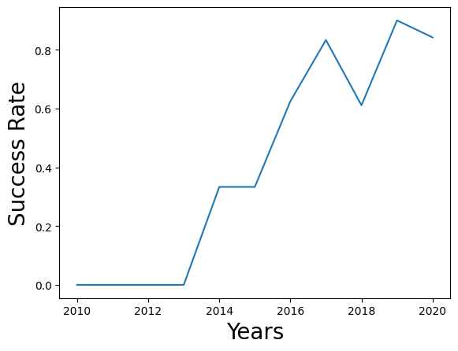
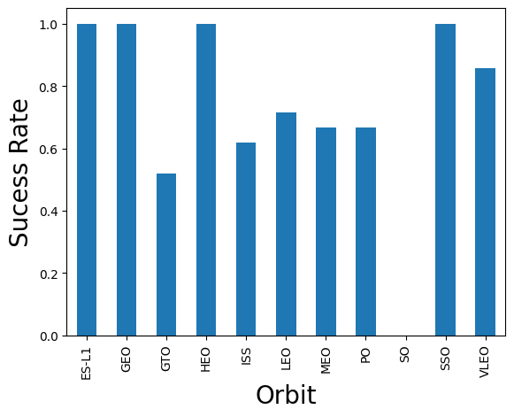
EDA with Data Visualization
Created categorical plot to visualize relationship of Flight Number vs Payload Mass in Kg and overlay outcome of the launch.
Created categorical plot to visualize relationship between Flight Number and Launch Site

Slide 12
EDA with SQL
Using bullet point format, summarize the SQL queries you performed
Add the GitHub URL of your completed EDA with SQL notebook, as an external reference and peer-review purpose

Slide 13
Build an Interactive Map with Folium
Summarize what map objects such as markers, circles, lines, etc. you created and added to a folium map
Explain why you added those objects
Add the GitHub URL of your completed interactive map with Folium map, as an external reference and peer-review purpose

Slide 14
Build a Dashboard with Plotly Dash
Summarize what plots/graphs and interactions you have added to a dashboard
Explain why you added those plots and interactions
Add the GitHub URL of your completed Plotly Dash lab, as an external reference and peer-review purpose

Slide 15
Predictive Analysis (Classification)
Summarize how you built, evaluated, improved, and found the best performing classification model
You need present your model development process using key phrases and flowchart
Add the GitHub URL of your completed predictive analysis lab, as an external reference and peer-review purpose

Slide 16
Results
Exploratory data analysis results
Interactive analytics demo in screenshots
Predictive analysis results

Slide 17

Section 2

Slide 18
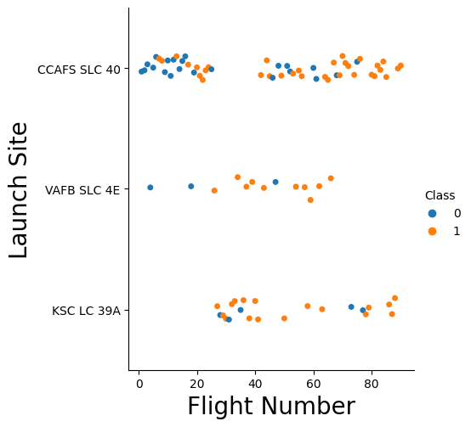
Flight Number vs. Launch Site
Show a scatter plot of Flight Number vs. Launch Site
Show the screenshot of the scatter plot with explanations

Slide 19
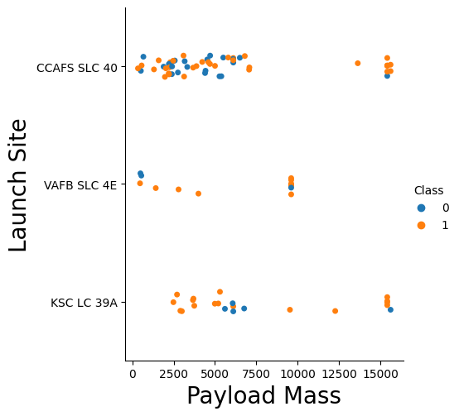
Payload vs. Launch Site
Show a scatter plot of Payload vs. Launch Site
Show the screenshot of the scatter plot with explanations

Slide 20
Success Rate vs. Orbit Type
Show a bar chart for the success rate of each orbit type
Show the screenshot of the scatter plot with explanations

Slide 21
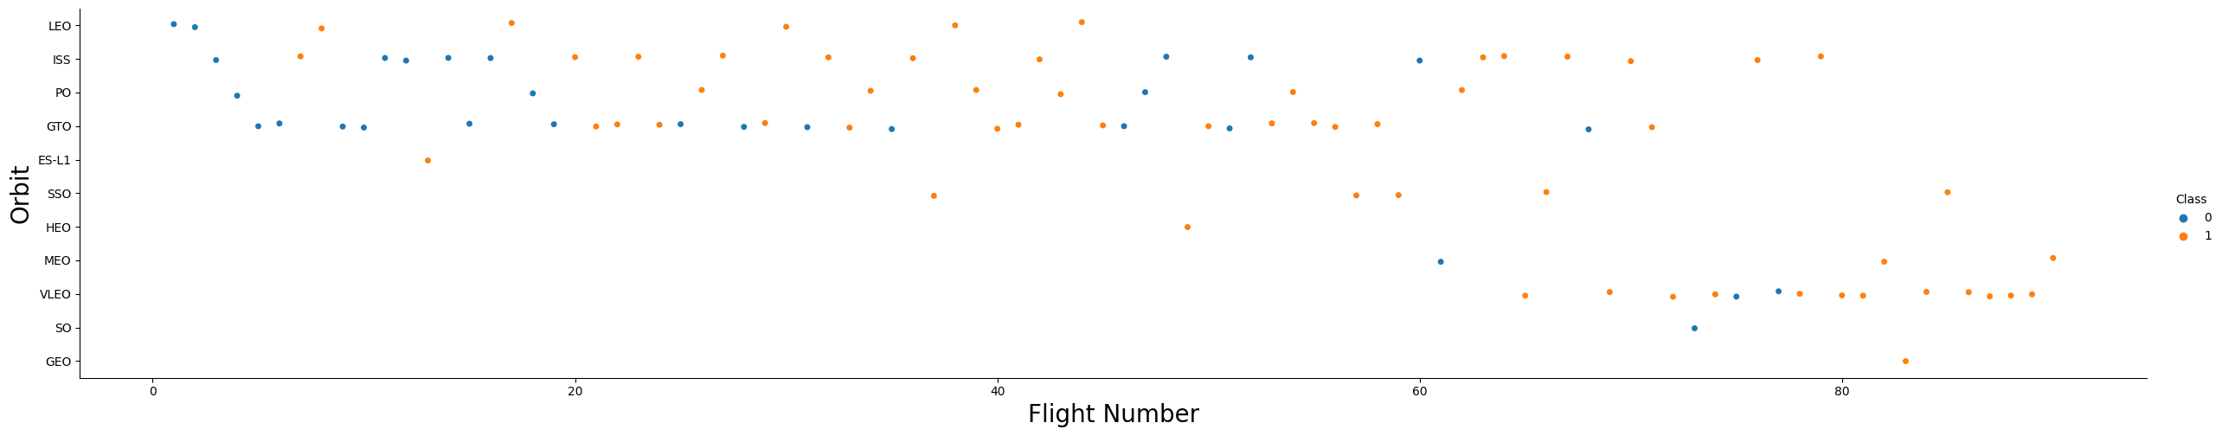
Flight Number vs. Orbit Type
Show a scatter point of Flight number vs. Orbit type
Show the screenshot of the scatter plot with explanations

Slide 22
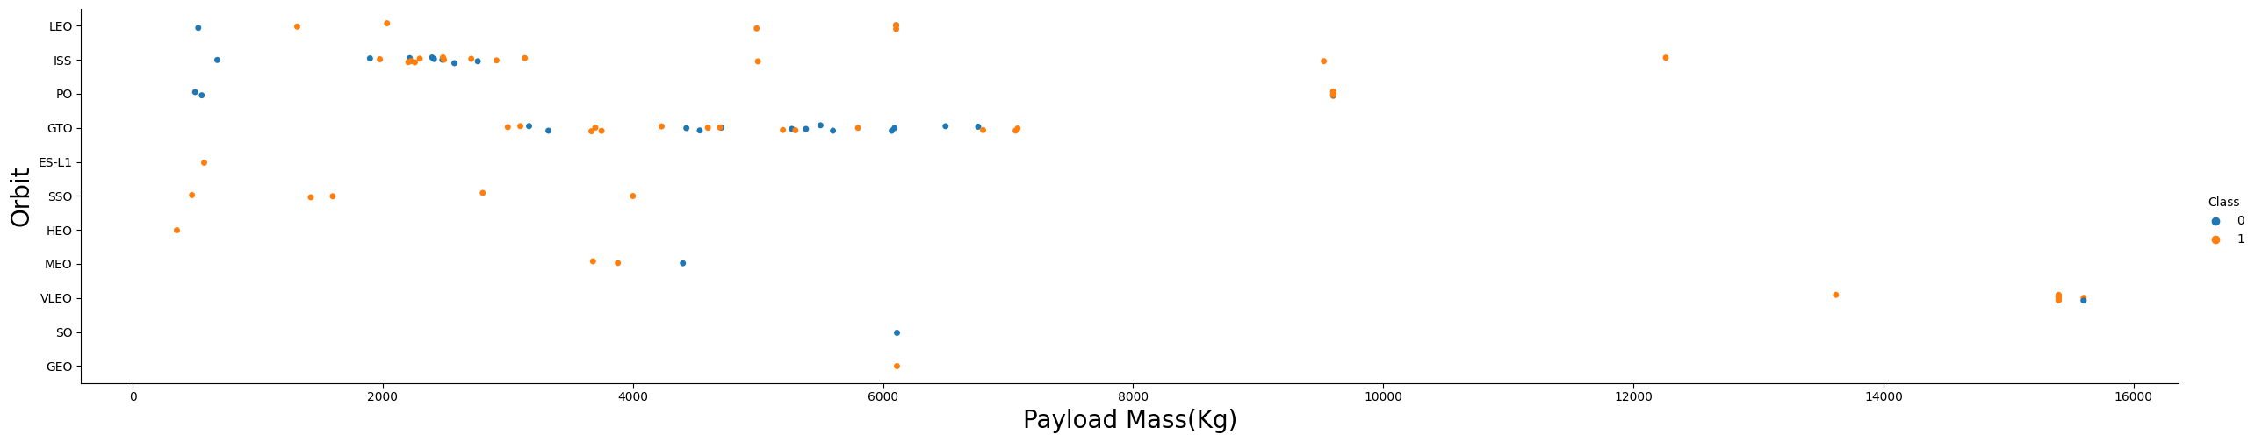
Payload vs. Orbit Type
Show a scatter point of payload vs. orbit type
Show the screenshot of the scatter plot with explanations

Slide 23
Launch Success Yearly Trend
Show a line chart of yearly average success rate
Show the screenshot of the scatter plot with explanations

Slide 24
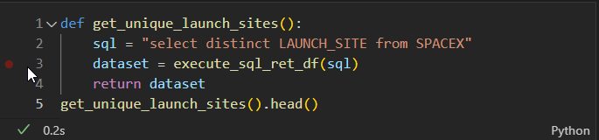
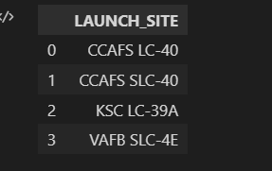
All Launch Site Names
Find the names of the unique launch sites
Present your query result with a short explanation here

Slide 25
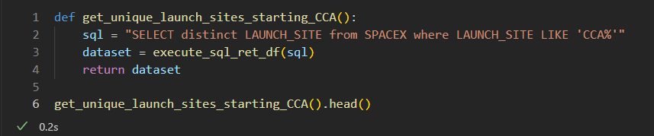
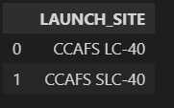
Launch Site Names Begin with 'CCA'
Find 5 records where launch sites begin with `CCA`
Present your query result with a short explanation here

Slide 26
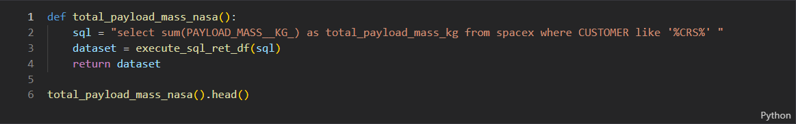
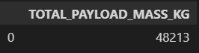
Total Payload Mass
Calculate the total payload carried by boosters from NASA
Present your query result with a short explanation here

Slide 27
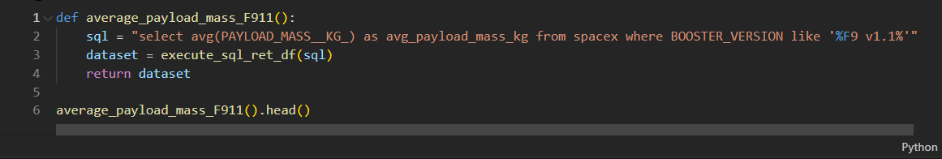
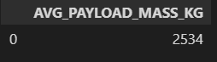
Average Payload Mass by F9 v1.1
Calculate the average payload mass carried by booster version F9 v1.1
Present your query result with a short explanation here

Slide 28
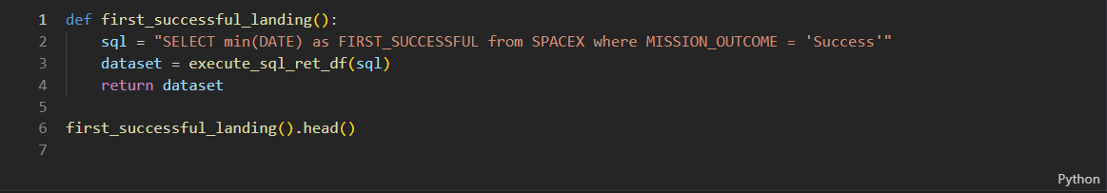
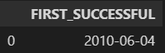
First Successful Ground Landing Date
Find the dates of the first successful landing outcome on ground pad
Present your query result with a short explanation here

Slide 29
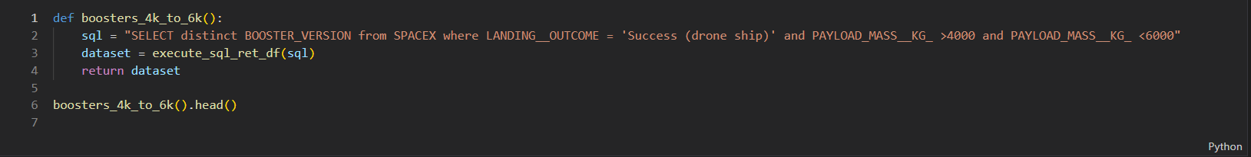
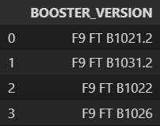
Successful Drone Ship Landing with Payload between 4000 and 6000
List the names of boosters which have successfully landed on drone ship and had payload mass greater than 4000 but less than 6000
Present your query result with a short explanation here

Slide 30
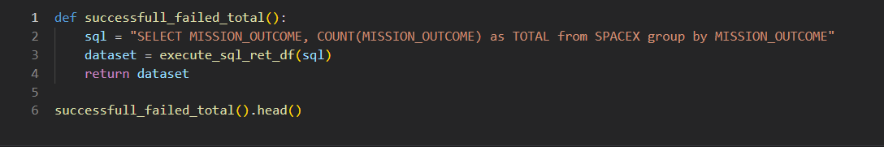
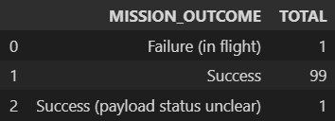
Total Number of Successful and Failure Mission Outcomes
Calculate the total number of successful and failure mission outcomes
Present your query result with a short explanation here

Slide 31
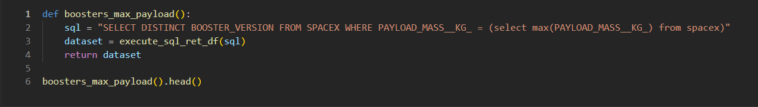
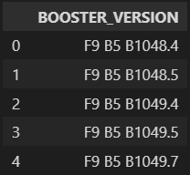
Boosters Carried Maximum Payload
List the names of the booster which have carried the maximum payload mass
Present your query result with a short explanation here

Slide 32
2015 Launch Records
List the failed landing_outcomes in drone ship, their booster versions, and launch site names for in year 2015
Present your query result with a short explanation here

Slide 33
Rank Landing Outcomes Between 2010-06-04 and 2017-03-20
Rank the count of landing outcomes (such as Failure (drone ship) or Success (ground pad)) between the date 2010-06-04 and 2017-03-20, in descending order
Present your query result with a short explanation here

Slide 34

Section 3

Slide 35
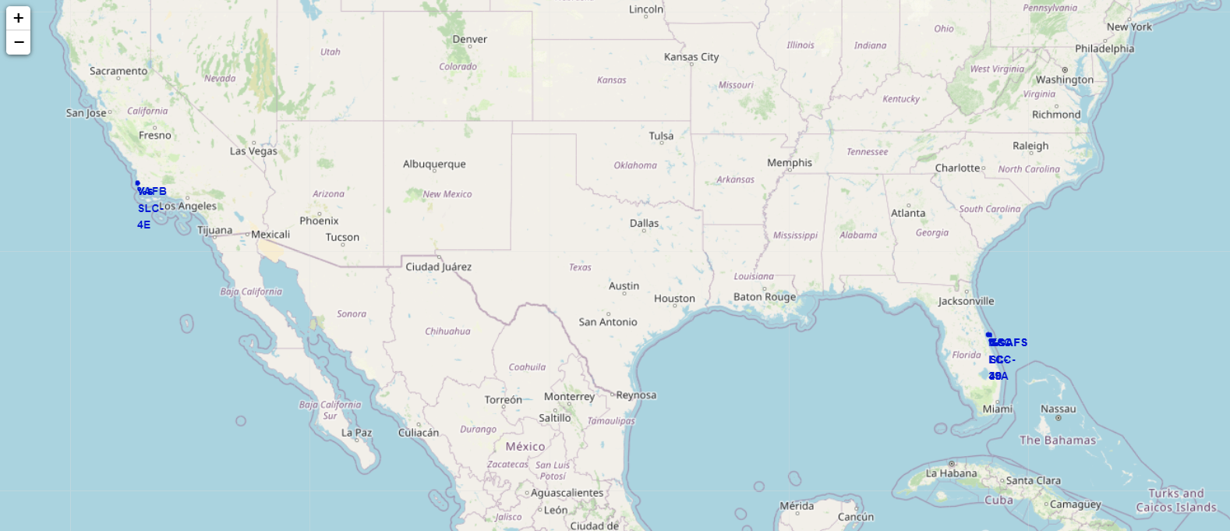
<Folium Map Screenshot 1>
Replace <Folium map screenshot 1> title with an appropriate title
Explore the generated folium map and make a proper screenshot to include all launch sites’ location markers on a global map
Explain the important elements and findings on the screenshot

Slide 36
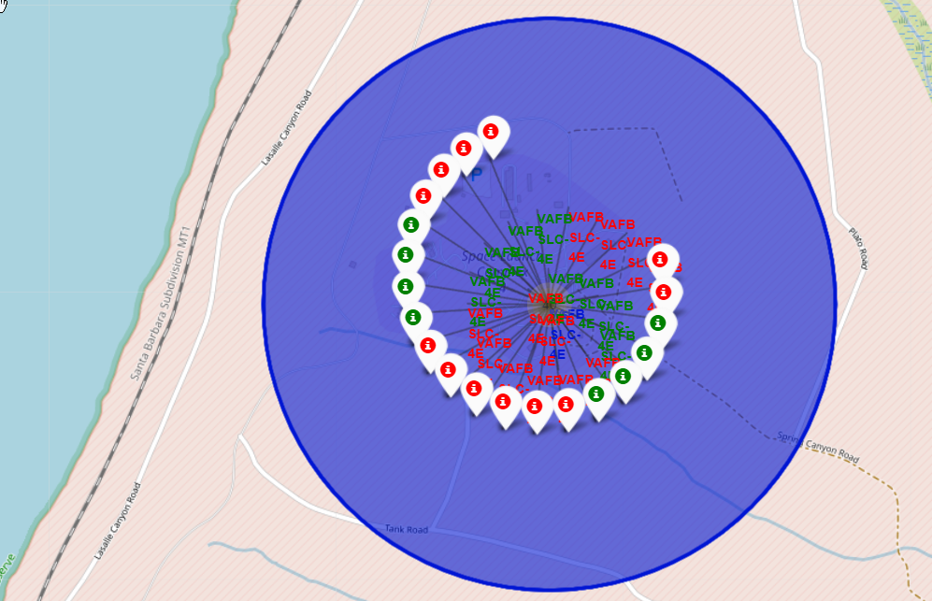
<Folium Map Screenshot 2>
Replace <Folium map screenshot 2> title with an appropriate title
Explore the folium map and make a proper screenshot to show the color-labeled launch outcomes on the map
Explain the important elements and findings on the screenshot

Slide 37
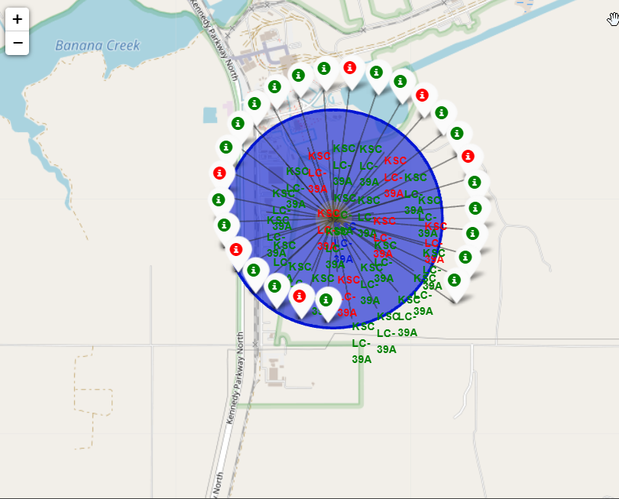

Slide 38
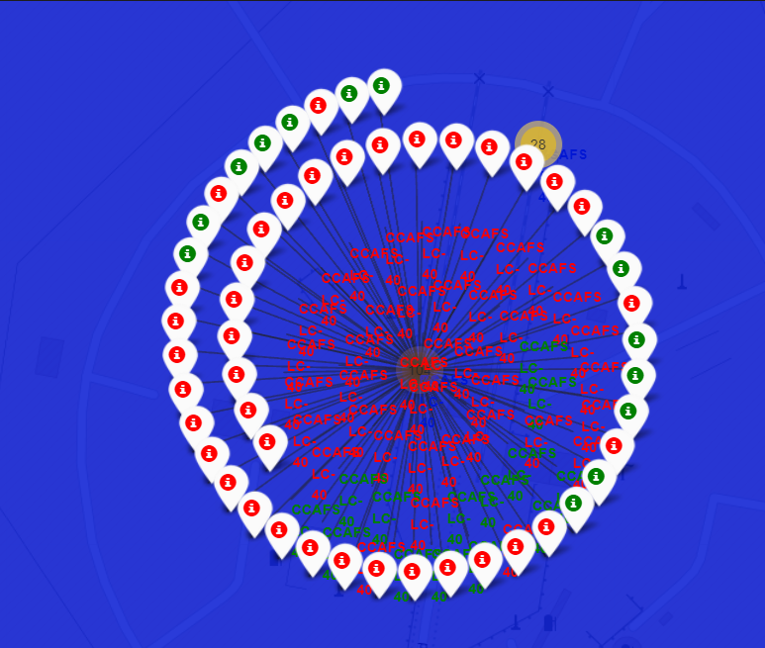
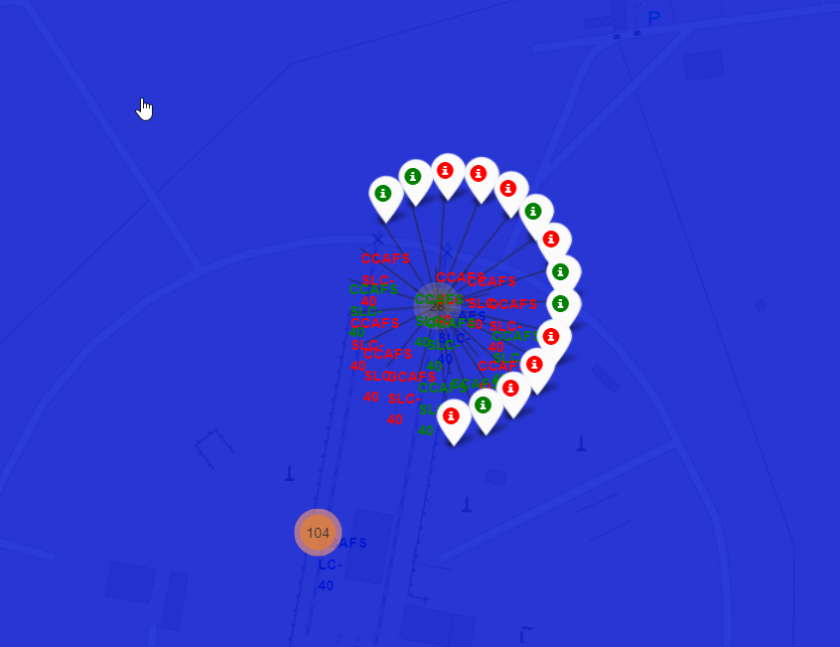
<Folium Map Screenshot 3>
Replace <Folium map screenshot 3> title with an appropriate title
Explore the generated folium map and show the screenshot of a selected launch site to its proximities such as railway, highway, coastline, with distance calculated and displayed
Explain the important elements and findings on the screenshot

Slide 39
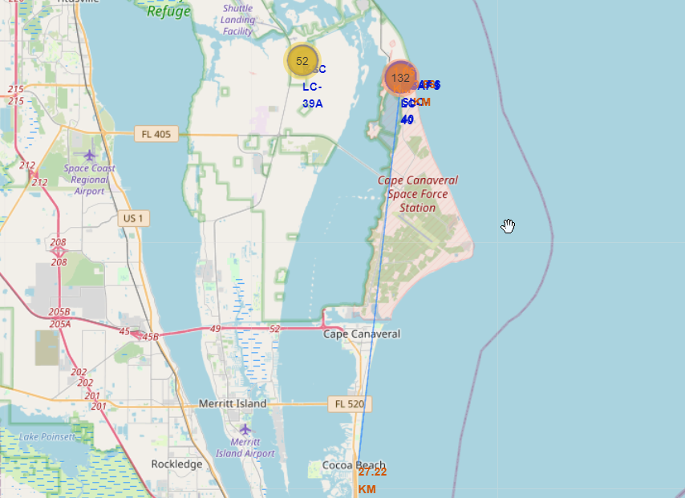
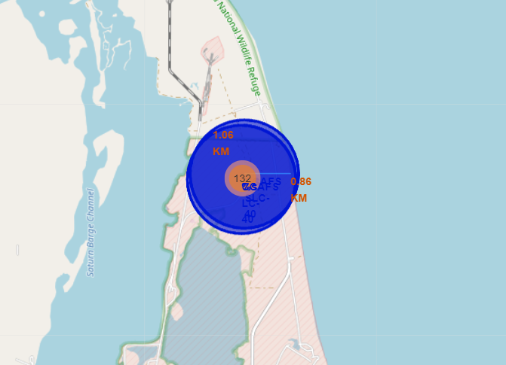
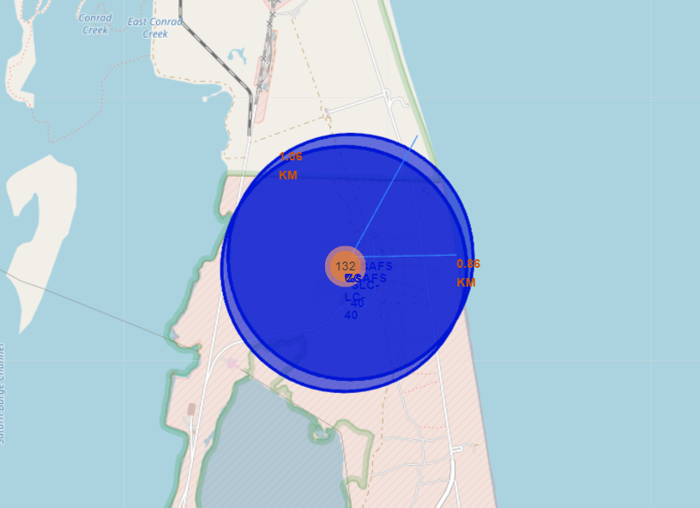
Launch site distance to critical infrastructure

Slide 40
* Are launch sites in close proximity to railways?
* Are launch sites in close proximity to highways?
* Are launch sites in close proximity to coastline?
* Do launch sites keep certain distance away from cities?

Slide 41

Section 4

Slide 42
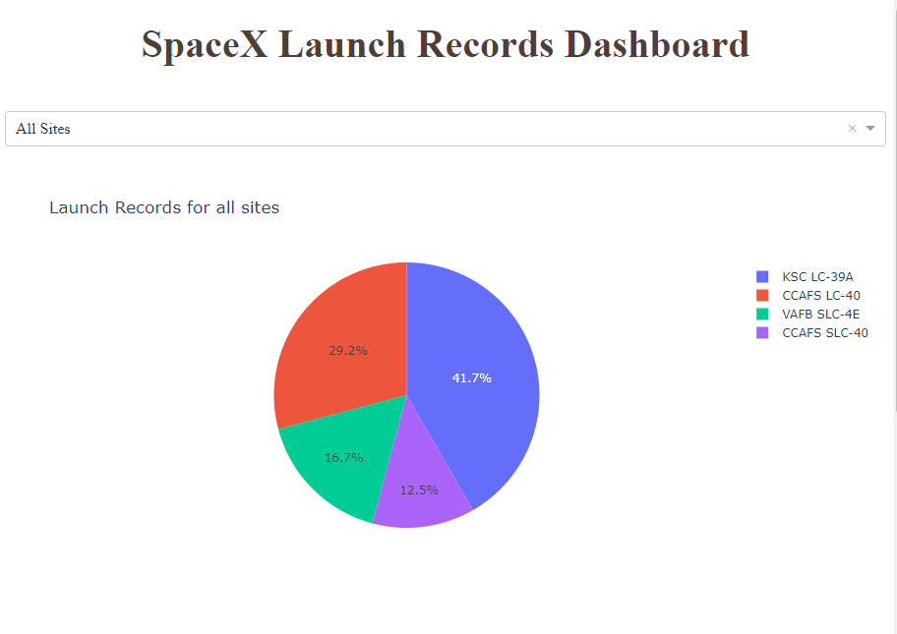
<Dashboard Screenshot 1>
Replace <Dashboard screenshot 1> title with an appropriate title
Show the screenshot of launch success count for all sites, in a piechart
Explain the important elements and findings on the screenshot

Slide 43
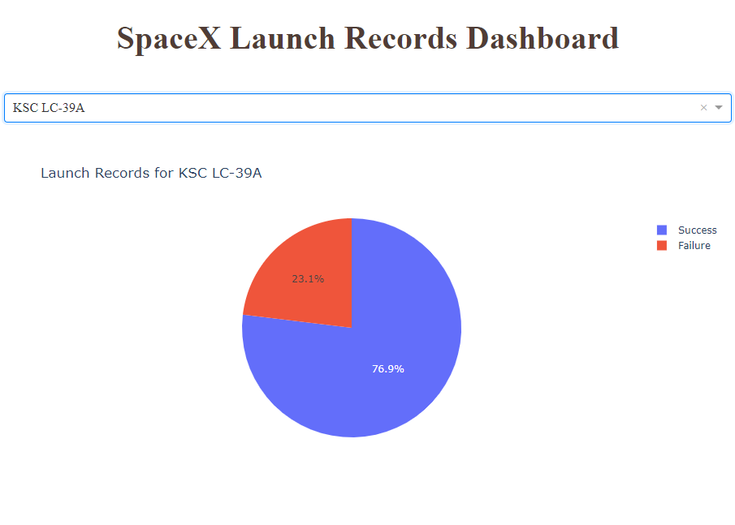
<Dashboard Screenshot 2>
Replace <Dashboard screenshot 2> title with an appropriate title
Show the screenshot of the piechart for the launch site with highest launch success ratio
Explain the important elements and findings on the screenshot

Slide 44
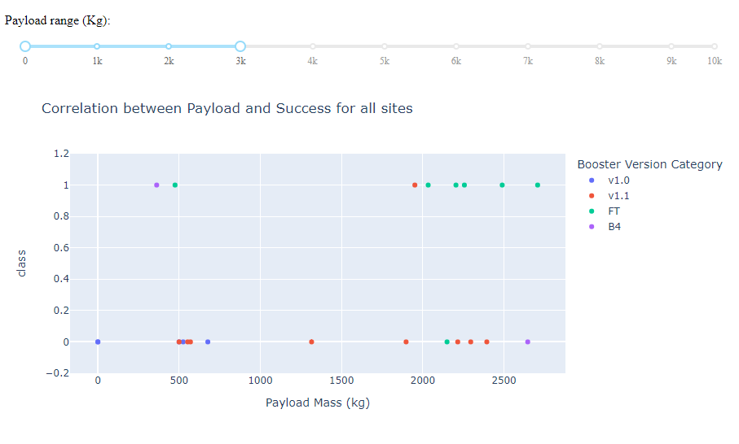
<Dashboard Screenshot 3>
Replace <Dashboard screenshot 3> title with an appropriate title
Show screenshots of Payload vs. Launch Outcome scatter plot for all sites, with different payload selected in the range slider
Explain the important elements and findings on the screenshot, such as which payload range or booster version have the largest success rate, etc.

Slide 45
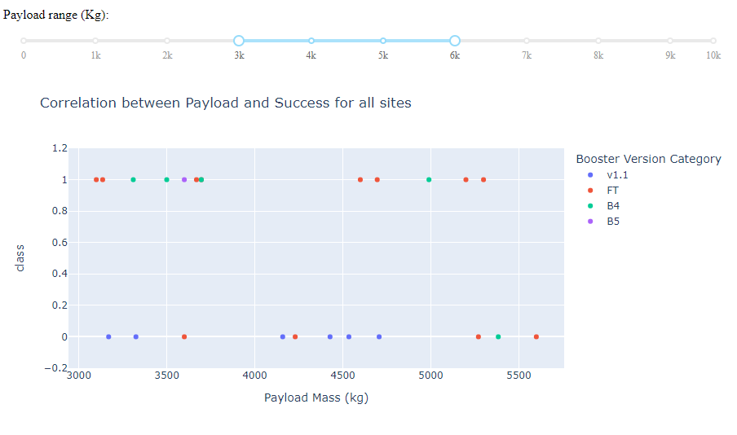

Slide 46
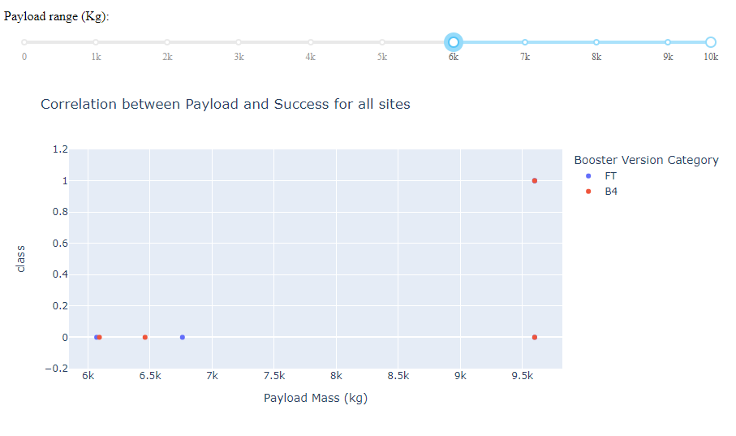

Slide 47

Section 5

Slide 48
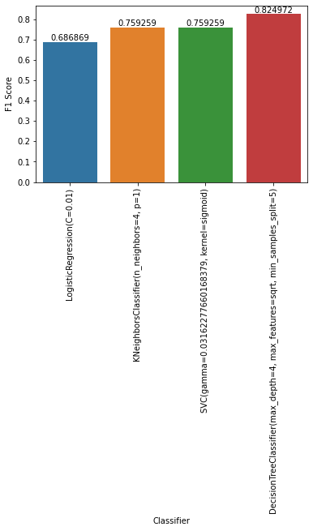
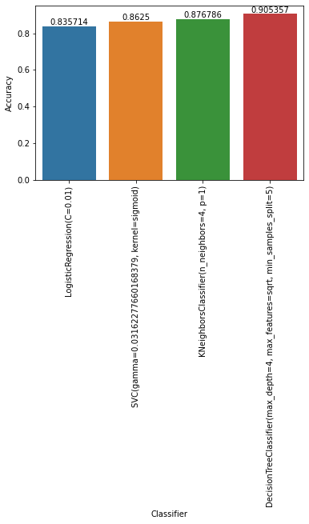
Classification Accuracy
[Text(0, 0, 'LogisticRegression(C=0.01)'), Text(1, 0, 'SVC(gamma=0.03162277660168379, kernel=sigmoid)'), Text(2, 0, 'KNeighborsClassifier(n_neighbors=4, p=1)'), Text(3, 0, 'DecisionTreeClassifier(max_depth=4, max_features=sqrt, min_samples_split=5)')])
Classification Algorightm Selection - IBM Cloud A.I.

Slide 49
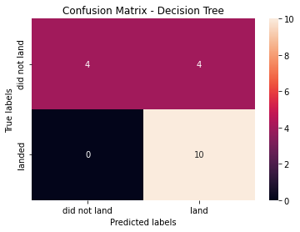
Confusion Matrix
The confusion matrix for the decision tree classifier shows that the classifier can distinguish between the different classes. The major problem is the false positives .i.e., unsuccessful landing marked as successful landing by the classifier.

Slide 50
Conclusions
- What factors determine if the rocket will land successfully? - The interaction amongst various features that determine the success rate of a successful landing. - What operating conditions needs to be in place to ensure a successful landing program.
We can conclude that:
The larger the flight amount at a launch site, the greater the success rate at a launch site.
Launch success rate started to increase in 2013 till 2020.
Orbits ES-L1, GEO, HEO, SSO, VLEO had the most success rate.
KSC LC-39A had the most successful launches of any sites.
The Decision tree classifier is the best machine learning algorithm for this task.

Slide 51
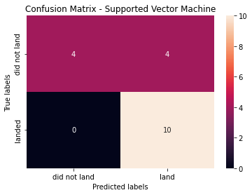

Confusion Matrix for remaining prediction models
Include any relevant assets like Python code snippets, SQL queries, charts, Notebook outputs, or data sets that you may have created during this project

Slide 52
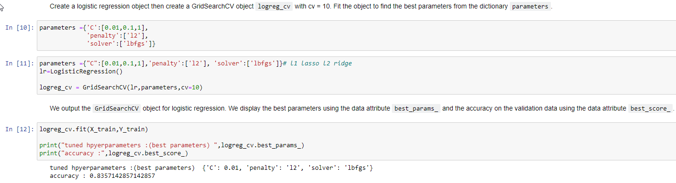
Predictive Model Fine Tunning – Logistic Regression

Slide 53
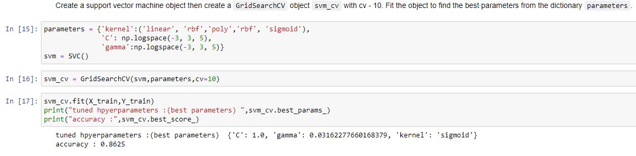
Predictive Model Fine Tunning – SVM

Slide 54
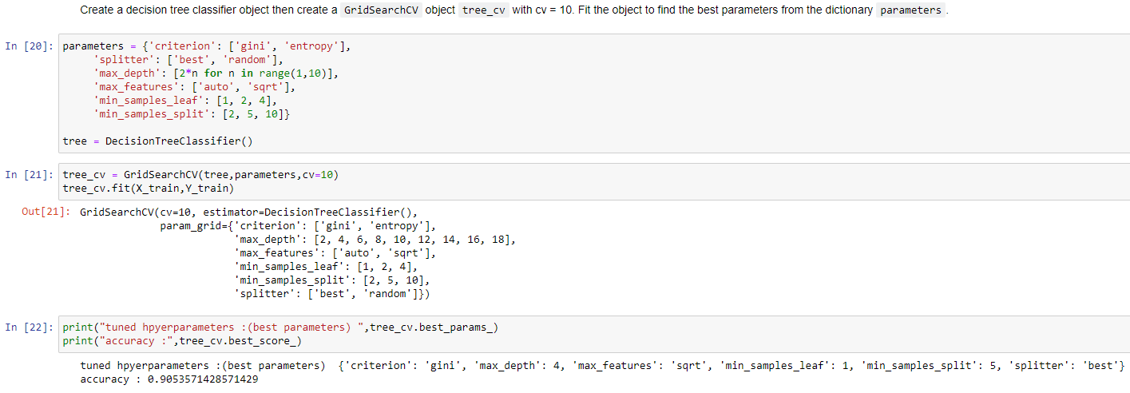
Predictive Model Fine Tunning – Decision Tree

Slide 55
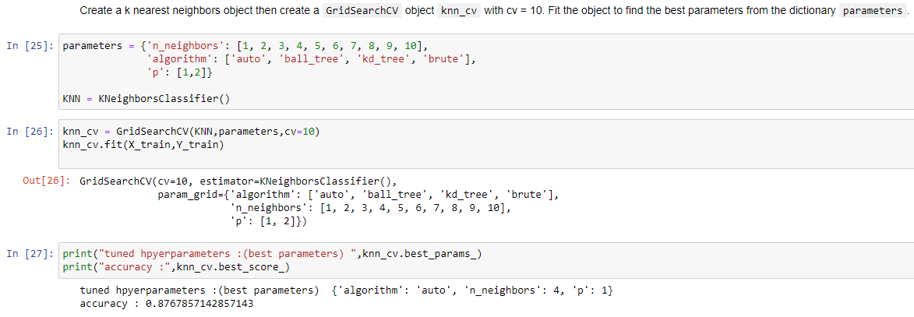
Predictive Model Fine Tunning – K Nearest Neighbours

Slide 56


